Slide 1
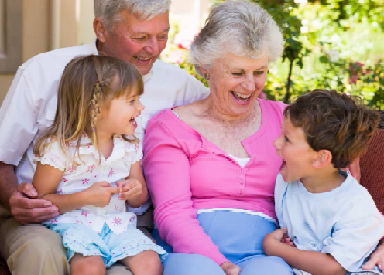
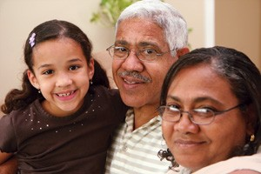
The Power of Grandparents Preventing Youth Prescription Drug Abuse

Slide 2
The Danger of Prescription Drug Misuse
While prescription drugs serve an important purpose when used under a doctor’s care, the misuse of prescription drugs is a growing, under-recognized problem that puts young lives at risk.
Rx Abuse Prevention Toolkit - from awareness to action

Slide 3
The Scary Statistics about RX Drugs
(National Survey on Drug Use and Health, 2010)

Slide 4
The Scary Statistics about RX Drugs
About 1 in 5 youth
Or 19 percent of young people ages 12 to 25 used prescription drugs non-medically within the past year.
(National Survey on Drug Use and Health, 2010)

Slide 5
A Growing Problem in SD County
Unintentional Deaths in San Diego County,
2011 to 2015
(San Diego Medical Examiner’s Office, 2013)

Slide 6
Most Abused RX Drugs
Hydrocodone
Commonly known as Vicodin
Used to relieve moderate to severe pain.
Oxycodone
Known as Oxycontin
Muscle Relaxer/High potential for abuse
Codeine
One example is Tylenol with Codeine
Respiratory depressant similar to morphine
Benzodiazepenes
Known as Valium or Xanax
Prescribed for anxiety/sleep problems

Slide 7
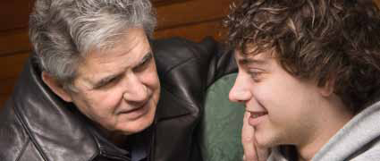
Your Role as a Grandparent
Children have a very special relationship with Grandma and Grandpa. Because of this grandparents can be such powerful allies in helping keep a kid off drugs.

Slide 8
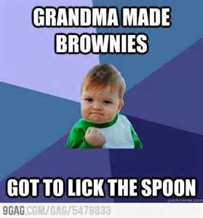
Why Kids Love their Grandparents
They listen to us.
They make us laugh.
They teach us how to do new things, like sew or crochet.
They are always up for an adventure.
They give us lots of yummy treats!!!
Notes:
Youth tells a story about spending time with grandparent!

Slide 9
The Power of a Grandparent
The bottom line is that grandparents are cool and relaxed. They’re not on the firing line every day. Some days a kid will hate their parents, but they will never hate their grandparents.
Use this to your advantage!!!

Slide 10
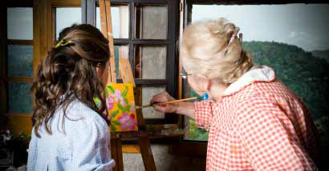
Spend Time Together
The more involved you are with your grandchild and the more time you spend with him or her, the closer you’ll be.
Watch TV or do some cooking together — maybe it’s the things that their parents don’t have time to do with them. Focus on the positive.

Slide 11
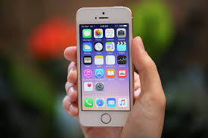
Grandparents Getting “Tech-y”
A great bonding experience is to get your grandkids to teach you the basics about computers and phones.
Have them teach you about
texting,
emailing,
video-conferencing
social media i.e. Facebook and Twitter
You can teach them about the art of the written letter, and how you communicated with your friends when you were their age.

Slide 12
Check Your Medicine Cabinets
Make sure you know what you have in your medicine cabinet.
Keep Inventory!
Lock up/store your prescriptions in a safe environment, especially when selling a home or having people over.

Slide 13
Why is Checking Your Medicine Cabinets So Important?
Friends and relatives are the most common source of pain relievers for non-medical use*. Such as OxyContin,
Vicodin, Xanax and Soma.
*Source of pain relievers for most recent nonmedical use among past year users (Substance Abuse and Mental Health Services Administration, 2008 National Survey on Drug Use and Health)

Slide 14
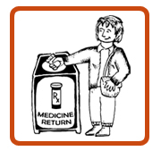
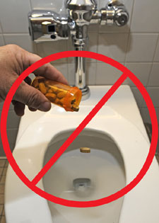
Dispose of RX Drugs Properly
The most important thing you can do is dispose of old or unused medications properly. Prescription drugs should never be flushed down the toilet or sink.
Annual Take Back Days and local permanent drop boxes are safe ways to properly dispose of medications you no longer need.
Notes:
Take medication exactly as prescribed
Store prescription drugs in locked and secure locations
Properly dispose of medications no longer needed
Promote safe medication practices and teach others to do the same

Slide 15
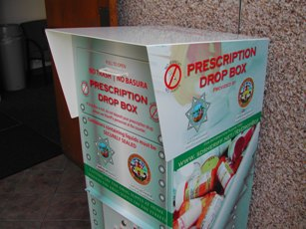
Permanent Drop Box Locations
Escondido Police Department
Escondido 700 W Grand Ave.
Carlsbad Police Department
Carlsbad 2560 Orion Way
SD County Sheriff Stations
Vista, 325 S. Melrose Dr.
Encinitas, 175 N. El Camino Real
San Marcos 182 Santar Pl.
Poway 13100 Bowron Rd, Poway
City of Oceanside Operation Center
4927 Oceanside Blvd.
National Take-Back Days
To find the collection site nearest you, visit: http://www.dea.gov

Slide 16
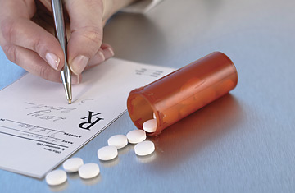
Prescription Drugs
Alcohol and Medication Interactions
Guidelines for Seniors
Medicines and other drugs or supplements
Treat/reduce the symptoms of many health problems.
However, they should be taken properly to make sure that they are safe and effective.

Slide 17
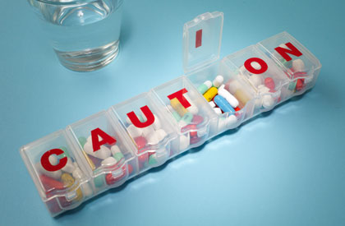
Drug Interactions
Certain foods, beverages, alcohol, caffeine, and even cigarettes can interact with medicines or supplements.
EX: Eating licorice or grapefruit can sometimes reduce the effects of blood pressure medicine or diuretic drugs.

Slide 18
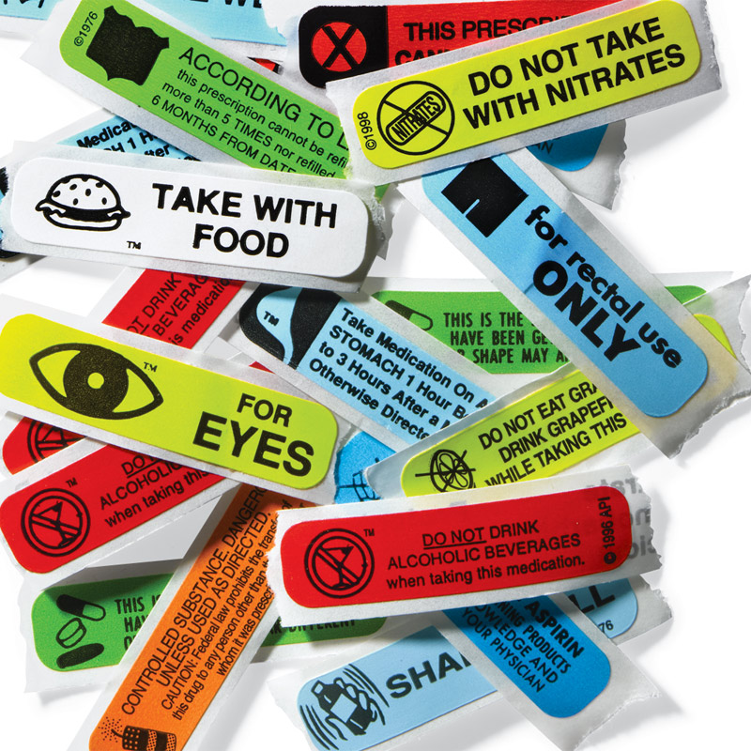
Drug Interactions
Can make the medicines or supplements less effective
May cause dangerous side effects or other problems (such as falls and confusion).
Sometimes people end up in the hospital because of these problems, particularly for alcohol-medication interactions.

Slide 19
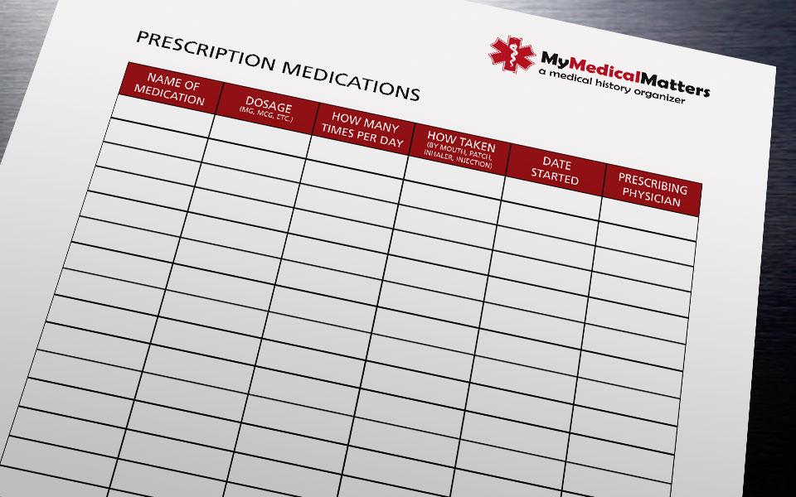
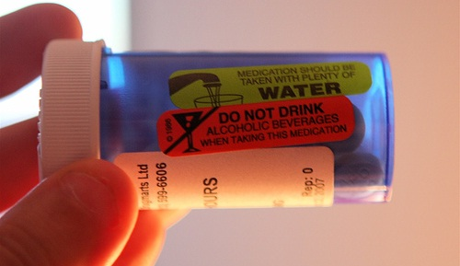
Risk Reduction and Rx Drugs
Keep a list of all your medications.
Carefully follow the instructions on your medications.
Let them know if you smoke or you drink alcohol, even if it is only occasionally.
If you do, ask them to explain how alcohol/tobacco will interact with your specific medications

Slide 20
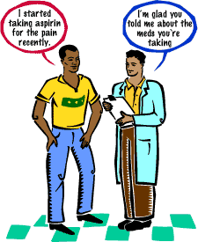
Risk Reduction and Rx Drugs
Make sure your doctor and pharmacist know about every drug you are taking.
Non-prescription drugs
Over the Counter (OTC) Drugs
Vitamins, minerals, and herbal drugs
If you have problems or experience side effects related to your medication, call your health care provider right away.

Slide 21
Questions or Comments?
Vista Community Clinic
www.vistacommunityclinic.org
North Coastal Prevention Coalition
www.northcoastalpreventioncoalition.org
760.631.5000 x7174

